Slide 1
Student Name : J. Janani Register No : 36324U18018 NM ID : F91744BD60C5FC7BEB64F15C0B7C908E Department : BSc(Computer Science ) College Name : Sree Abiraami Arts & Science College for Women University : Thiruvalluvar University Date of Birth : 08/04/2007 Gender : Female Current semester : 3
DIGITAL PORTFOLIO

Slide 2
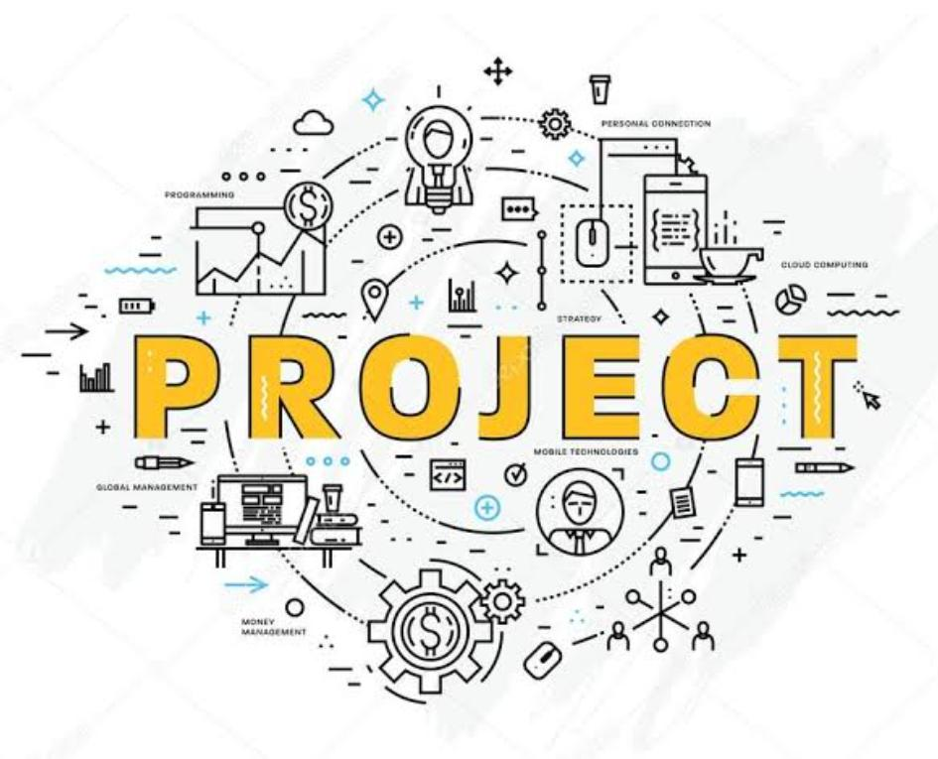
📌 PROJECT TITLE :
1.My digital portfolio: A front-end development project
2. Student digital portfolio using HTML, CSS & JavaScript
3. Personal portfolio website – A front-end project
4. Janani’s digital portfolio: A modern web design approach

Slide 3

💡AGENDA
1.Problem Statement 2.Project Overview 3.End Users 4.Tools and Technologies 5.Portfolio design and layout 6.Features and Functionality 7.Result and Screenshot 8.Conclusion
9.GitHub link

Slide 4

Problem Statement
In today’s competitive world, resumes alone cannot fully represent a student’s skills, creativity, and achievements. A responsive portfolio website solves this problem by providing an interactive space to highlight projects, skills, and accomplishments effectively.

Slide 5
Project overview
➪ Project overview: personal portfolio website.
➪ Core features:
☞ About
☞ Certificate
☞ Contact
☞ Skills
☞ Project
➪ Main idea:
☞ Create a personal portfolio website to showcase about , certificate & achievements, skills, projects & contact.

Slide 6

Who Are the end users?
➪ The student digital portfolio can be beneficial for a wide range of users:
* Student – to showcase their academic progress, skills, projects, and certifications in a structured digital format.
* Job seekers – to present their resume and achievements interactively, helping them stand out in recruitment processes.
* Freelancers – to display their work, technical expertise, and client projects to attract potential opportunities.
* Professionals – to maintain an online profile that highlights their experience, achievements, and career growth.

Slide 7
Tools And Techniques
☞To develop the student digital portfolio, the following tools and techniques are used:
* Html (hypertext markup language):
The content of the portfolio, including sections like about, education, skills, projects, certificate and contact.
* CSS (cascading style sheets): for designing and styling the web pages
* JavaScript (JS): for adding interactivity and dynamic features such as navigation menus, form validation, and smooth transitions.
* Code editor – visual studio code (VS code)
* Web browser -(google chrome/edge)

Slide 8

Portfolio design layout
1. About me
🔸 A brief introduction of Janani. J
🔸 Educational background (B.Sc. Computer science
2. Projects
🔸Showcasing academic and personal project
🔸 Each project with a title, description, tools used, and GitHub/demo link (if available)
3. Skills
🔸 List of technical skills (HTML, CSS, JavaScript, C, python, etc.)
🔸Soft skills (teamwork, communication, problem- solving)
🔸Visual representation (skill bars or icons)
4. Contact
🔸Contact form (name, email, message)
🔸Direct contact details (email ID, LinkedIn, GitHub link)

Slide 9
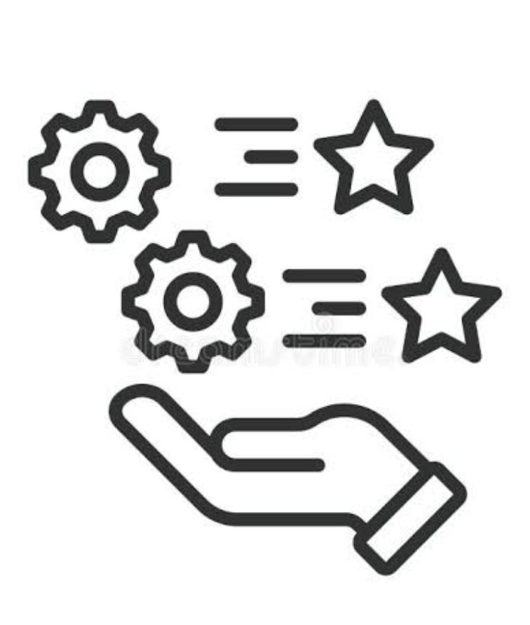
🎗️Features and functionality
1.Navigation Bar (menu / header).
✯ Smooth scrolling to different sections.
✯ Highlight active section when scrolling.
2. Project section grid layout to showcase projects (with image + title).
✯On hover → show description used
(HTML, CSS, JS, python, etc.).
✯ Link to GitHub repository or live demo.
3. Contact section simple form: name, email, message.
✯ Email integration
✯ Social media icons (LinkedIn, GitHub, etc)
4. Responsive design mobile + tablet + desktop compatible.
✯ Flexible grid layout for projects and skills.
✯ Navigation menu to hamburger in small screens.

Slide 10
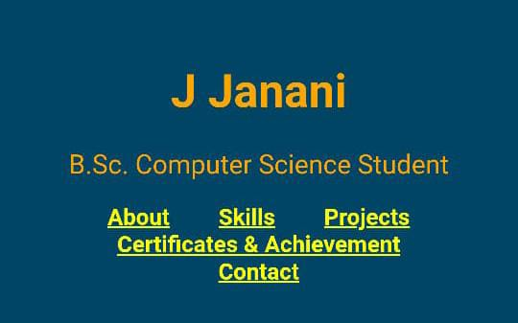
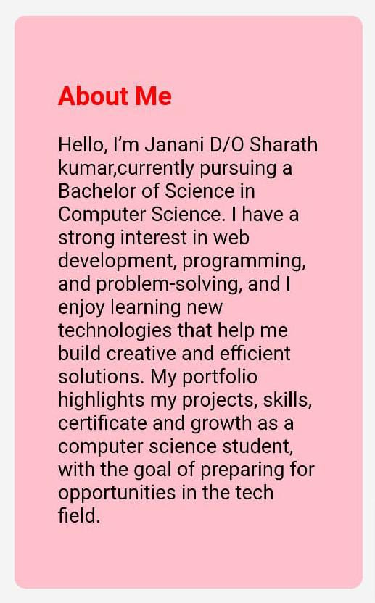
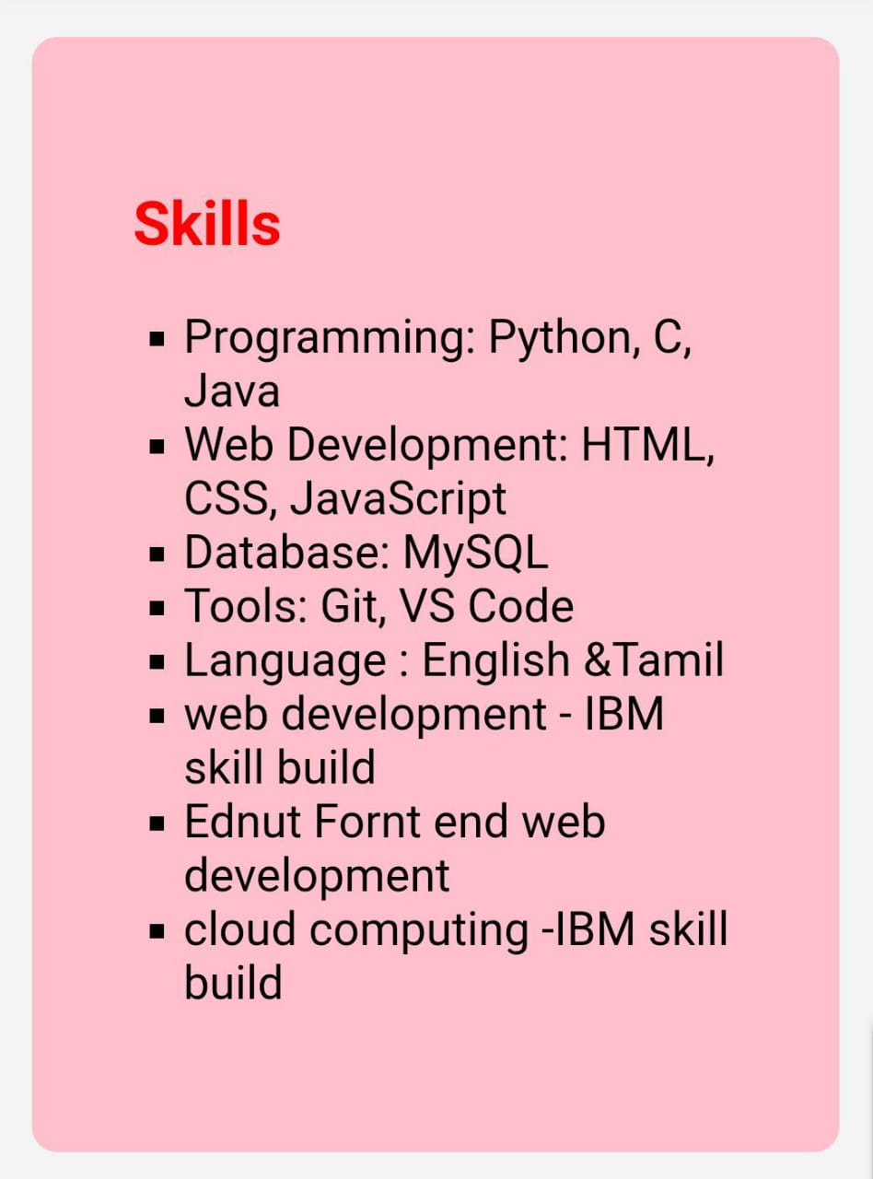

RESULT AND SCREENSHOT

Slide 11
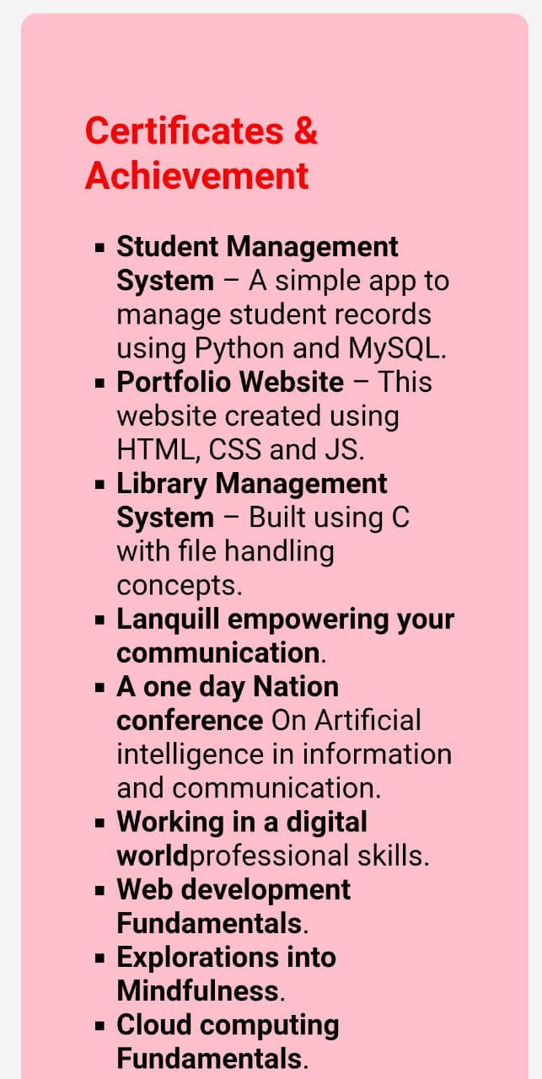
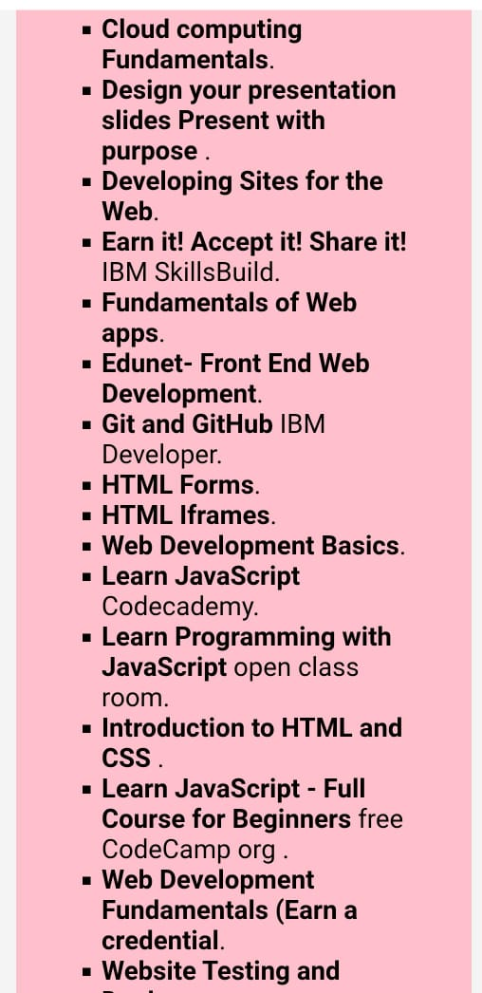

Slide 12
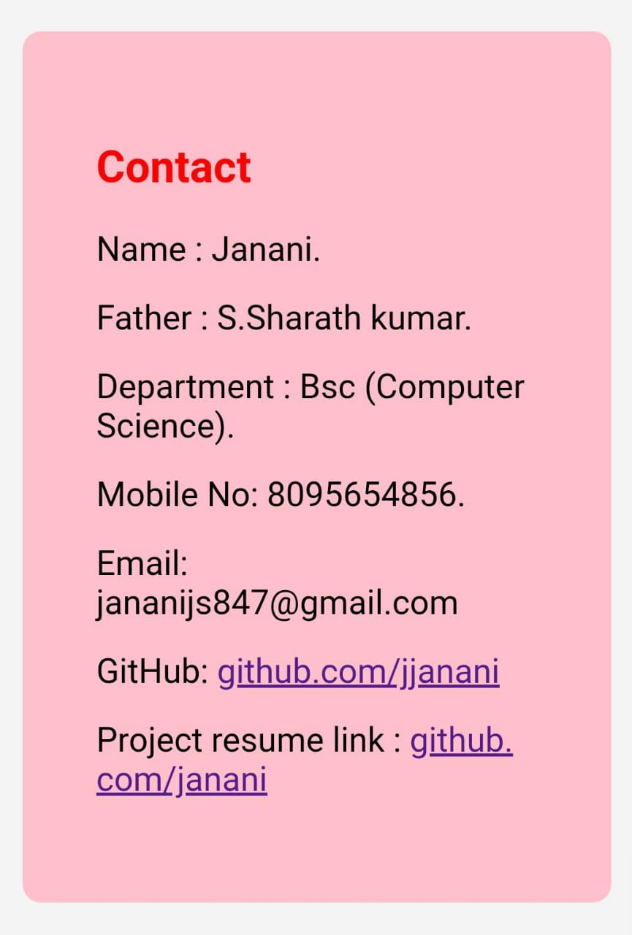
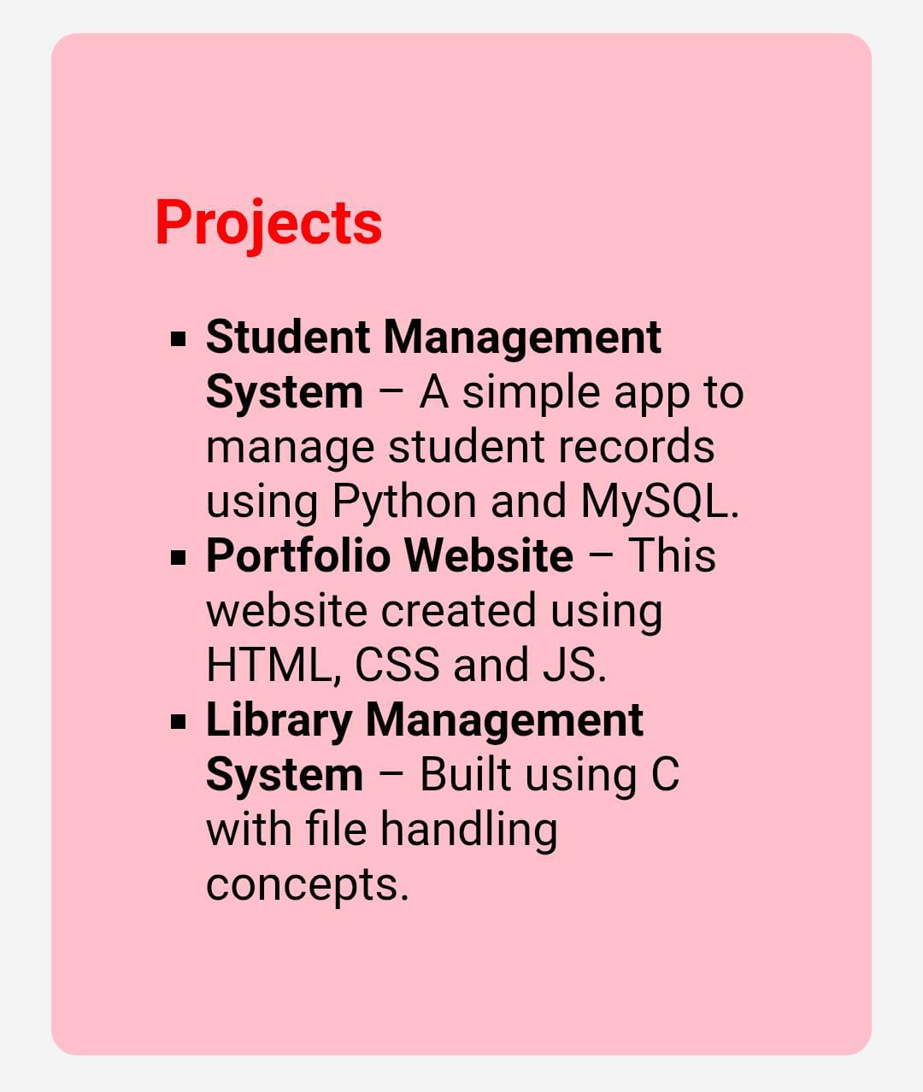
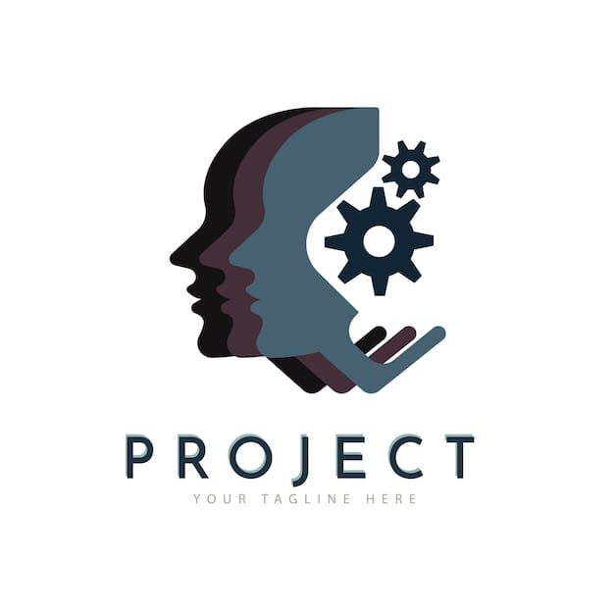

Slide 13


CONCLUSION
HIGHLIGHTS OF OUR PROJECT
☞︎ My project highlights responsive design, interactive features, easy navigation, showcasing skills and projects effectively for students and professionals.
FINAL SUMMARY
☞︎ This portfolio project showcases my skills, projects, and achievements with a clean, responsive design. It serves as a professional platform for future opportunities.
BENEFITS OF SOCIETY
☞︎ A portfolio project benefits society by showcasing skills that inspire learning and innovation.

Slide 14
GITHUB LINK
This is my GitHub URL :jananijs0819/portfolio
My Project and My Digital portfolio link : https://jananijs0819.github.io/portfolio/

Slide 15
Thank you:
Presented by :
Name : J. Janani
Year : Second year
Department : BSc (Computer Science)
College name : Sree Abiraami Arts and Science college for womem
Place : Keelalathur

